Slide 1
Applications of Bifactor Models
to Big Five Data
Michael Biderman
University of Tennessee at Chattanooga
www.utc.edu/michael-biderman
Michael-Biderman@utc.edu
Master tutorial presented at the 28th Annual Conference of The Society for Industrial and Organizational Psychology, Houston, TX. 2013.
A recording of the presentation is available on the above web site.

Slide 2
Thanks to
Nhung T. Nguyen
Towson University
Collaborator for more than 10 years
International Personality Item Pool
www.ipip.ori.org

Slide 3
Bifactor Model
Confirmatory Factor Analysis (CFA) or Exploratory Factor Analysis (EFA) model applicable to a dataset which may represent both a single overarching construct and multiple subconstructs
The model contains one general factor and multiple group factors.
The general factor represents the overarching construct and each group factor represents one of the subconstructs.
The general factor influences all indicators.
Each group factor influences only the indicators for a subconstruct.
Bifactor models are also called nested models.

Slide 4
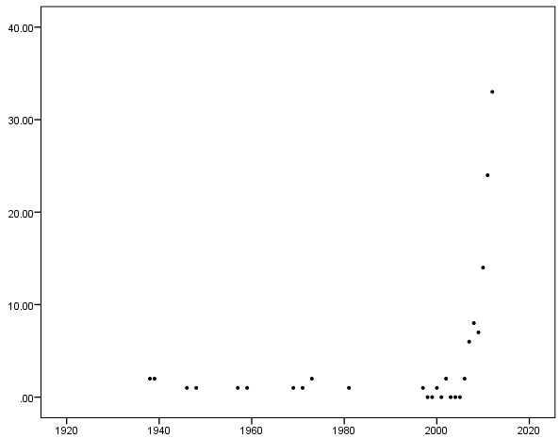
Why are we here?
Application of bifactor models has increased dramatically in past 10 years.
Number of hits in PsycINFO for “bifactor” through 2012
40
30
20
10
0
1920
1940
1960
1980
2000
2020

Slide 5
Three Examples of Data for which a bifactor model might be applicable
1. WAIS-III Intelligence subtests
Brunner, M., Nagy, G., & Wilhelm, O. (2012). A tutorial on hierarchically structured constructs. Journal of Personality, 80, 796-846.
14 subtests of intellectual functioning
Verbal Comprehension
Perceptual Organization
Working Memory
Processing Speed
Overarching construct: General intelligence
Subconstructs: VC, PO, WM, PS
Information
Vocabulary
Similarities
Comprehension
Object Assembly
Blok Design
Pict Completion
Matrix Reasoning
Pict Arrangement
Digit Span
Sequencing
Arithmetic
Dig-Symbol Coding
Symbol Search

Slide 6
2. The Observer Alexithymia Scale (OAS)
Reise, S. P., Moore, T. M., & Haviland, M. G. (2010). Bifactor models and rotations: Exploring the extent to which multidimensional data yield univocal scale scores. Journal of Personality Assessment, 92, 544-559.
33 observer-rated items
5 groups of items
Distant
Uninsightful
Somatizing
Humorless
Rigid
Overarching construct: Alexithymia
Subconstructs: D, U, S, H, R
Distant1
Distant2
Distant3
Distant4
Distant5
Distant6
Distant7
Distkant8
Distant9
Distant10
Uninsightful1
Uninsightful2
Uninsightful3
Uninsightful4
Uninsightful5
Uninsightful6
Uninsightful7
Uninsightful8
Somaticizing1
Somaticizing2
Somaticizing3
Somaticizing4
Somaticizing5
Humorless1
Hiumorless2
Humorless3
Humorless4
Humorless6
Rigid1
Rigid2
Rigid3
Rigid4
Rigid5

Slide 7
3. Big Five Questionnaires
For example, the 50-item Sample Questionnaire on the IPIP website at www.ipip.ori.org
Biderman, M. D., Nguyen, N. T., Cunningham, C. J. L., & Ghorbani, N. (2011). The ubiquity of common method variance: The case of the Big Five. Journal of Research in Personality, 45, 417-429.
5 groups of items
Extraversion
Agreeableness
Conscientiousness
Stability
Openness to Experience
Subconstructs: E, A, C, S, and O
Overarching construct: Hmm. General Factor of Personality?
I’ll call it the GFP here.
Extrav1
Extrav2
Extrav3
Extrav4
Extrav5
Extrav6
Extrav7
Extrav8
Extrav9
Extrav10
Agree1
Agree2
Agree3
Agree4
Agree5
Agree6
Agree7
Agree8
Agree9
Agree10
Consc1
Consc2
Consc3
Consc4
Consc5
Consc6
Consc7
Consc8
Consc9
Consc10
Stabil1
Stabil2
Stabil3
Stabil4
Stabil5
Stabil6
Stabil7
Stabil8
Stabil9
Stabil10
Open1
Open2
Open3
Open4
Open5
Open6
Open7
Open8
Open9
Open10

Slide 8
The basic data for each example
Big 5
Extrav1
Extrav2
WAIS-III
OAS
Extrav3
Extrav4
Extrav5
Distant1
Extrav6
Distant2
Extrav7
Extrav8
Information
Distant3
Extrav9
Distant4
Extrav10
Vocabulary
Distant5
Agree1
Similarities
Distant6
Agree2
Distant7
Agree3
Compreh
Distkant8
Agree4
Distant9
Agree5
Obj Assem
Distant10
Agree6
Agree7
Blk Design
Uninsightful1
Agree8
Uninsightful2
Agree9
Pct Compl
Uninsightful3
Agree10
Mat Reas
Uninsightful4
Consc1
Uninsightful5
Consc2
Pict Arrange
Uninsightful6
Consc3
Consc4
Digit Span
Subtest scores.
Uninsightful7
Responses to individual items
Consc5
Uninsightful8
Consc6
Sequencing
Consc7
Somaticizing1
Consc8
Arithmetic
Somaticizing2
Consc9
Somaticizing3
Consc10
Dig-Sym
Somaticizing4
Stabil1
Sym Search
Somaticizing5
Stabil2
Stabil3
Humorless1
Stabil4
Hiumorless2
Stabil5
Humorless3
Stabil6
Stabil7
Humorless4
Stabil8
Humorless6
Stabil9
Stabil10
Rigid1
Open1
Rigid2
Open2
Rigid3
Open3
Rigid4
Open4
Rigid5
Open5
Open6
Open7
Open8
Open9
Open10

Slide 9
Possible models of the data sets
1. Single Factor only
2. Multiple correlated factors
3. Higher order factor
4. Bifactor

Slide 10
Model 1: Single factor models of each data set
Big 5
Extrav1
OAS
Extrav2
Extrav3
Extrav4
Extrav5
Extrav6
Distant1
Extrav7
Distant2
Extrav8
WAIS-III
Distant3
Extrav9
Distant4
Extrav10
Distant5
Agree1
Distant6
Agree2
Information
Distant7
Agree3
Distkant8
Agree4
Vocabulary
Distant9
Agree5
Agree6
Similarities
Distant10
Agree7
Agree8
Compreh
Uninsightful1
Agree9
Uninsightful2
Agree10
Obj Assem
Uninsightful3
Consc1
Blk Design
Uninsightful4
Consc2
Uninsightful5
Consc3
Pct Compl
Uninsightful6
Consc4
g
Uninsightful7
Consc5
GFP
Mat Reas
Uninsightful8
Alx
Consc6
Pict Arrange
Consc7
Somaticizing1
Consc8
Somaticizing2
Consc9
Digit Span
Somaticizing3
Consc10
Sequencing
Somaticizing4
Stabil1
Stabil2
Arithmetic
Somaticizing5
Stabil3
Humorless1
Stabil4
Dig-Sym
Hiumorless2
Stabil5
Stabil6
Sym Search
Humorless3
Stabil7
Humorless4
Stabil8
Humorless6
Stabil9
Stabil10
Rigid1
Open1
Rigid2
Open2
Rigid3
Open3
Rigid4
Open4
Rigid5
Open5
Open6
Open7
Open8
Open9
Open10

Slide 11
What’s good about single factor models?
Parsimony – Variance in all of the indicators is accounted for by only one factor
What’s bad?
Differences between / relationships among subconstructs not accounted for

Slide 12
Model 2: Multiple correlated factor models of each data set
Big 5
Extrav1
OAS
Extrav2
Extrav3
Extrav4
E
Extrav5
Distant1
Extrav6
Extrav7
WISC-III
Distant2
Extrav8
Distant3
Extrav9
Distant4
D
Extrav10
Distant5
Agree1
Information
Distant6
Agree2
Distant7
Agree3
Vocabulary
VC
Distkant8
Agree4
A
Distant9
Agree5
Similarities
Distant10
Agree6
Agree7
Compreh
Uninsightful1
Agree8
Uninsightful2
Agree9
Obj Assem
Uninsightful3
Agree10
Blk Design
Uninsightful4
U
Consc1
PO
Uninsightful5
Consc2
Pct Compl
Consc3
Uninsightful6
Consc4
C
Mat Reas
Uninsightful7
Consc5
Uninsightful8
Consc6
Pict Arrange
Consc7
Somaticizing1
Consc8
Digit Span
WM
Somaticizing2
S
Consc9
Sequencing
Somaticizing3
Consc10
Somaticizing4
Stabil1
Arithmetic
Somaticizing5
Stabil2
Stabil3
PS
Humorless1
Stabil4
S
Dig-Sym
Hiumorless2
H
Stabil5
Sym Search
Humorless3
Stabil6
Stabil7
Humorless4
Stabil8
Humorless6
Stabil9
Stabil10
Rigid1
R
Open1
Rigid2
Open2
Rigid3
Open3
O
Rigid4
Open4
Rigid5
Open5
Open6
Open7
Open8
Open9
Open10

Slide 13
What’s good about multiple factor models?
Differences / relationships between subconstructs are accounted for
What’s bad?
Can’t parsimoniously account for effects of a single causal factor

Slide 14
Model 3: Higher order factor models of each data set
Big 5
Extrav1
R_{E}
OAS
Extrav2
Extrav3
Extrav4
E
Extrav5
WAIS-III
Distant1
R_{D}
Extrav6
Distant2
Extrav7
Extrav8
Distant3
Extrav9
R_{VC}
Distant4
D
Extrav10
R_{A}
Information
Distant5
Agree1
Distant6
Agree2
Vocabulary
VC
Distant7
Agree3
Distkant8
Agree4
A
Similarities
Distant9
Agree5
Distant10
Agree6
Compreh
Agree7
R_{PO}
Uninsightful1
R_{U}
Agree8
Obj Assem
Uninsightful2
Agree9
Blk Design
Uninsightful3
Agree10
R_{C}
PO
Uninsightful4
U
Consc1
Pct Compl
Uninsightful5
Consc2
Uninsightful6
Consc3
Mat Reas
Consc4
C
GFP
Pict Arrange
R_{WM}
g
Uninsightful7
Alx
Consc5
Uninsightful8
R_{S}
Consc6
Consc7
Digit Span
WM
Somaticizing1
Consc8
Sequencing
Somaticizing2
S
Consc9
Somaticizing3
Consc10
R_{S}
Arithmetic
Somaticizing4
Stabil1
Somaticizing5
Stabil2
Dig-Sym
PS
R_{H}
Stabil3
Humorless1
Stabil4
S
Sym Search
Hiumorless2
H
Stabil5
R_{PS}
Humorless3
Stabil6
Stabil7
Humorless4
Stabil8
Humorless6
R_{R}
Stabil9
Stabil10
R_{O}
Rigid1
R
Open1
Rigid2
Open2
Rigid3
Open3
O
Rigid4
Open4
Rigid5
Open5
Open6
Open7
Open8
Open9
Open10

Slide 15
What’s good about higher order models?
Represent BOTH effects of a single overarching construct and acknowledge differences between subconstructs
What’s bad?
General factor does not have direct effects on the indicators.
Difficult to show how the unique aspects of the subconstructs (the residuals) are related to the observations

Slide 16
Model 4: Bifactor models of each data set
Big 5
Extrav1
OAS
Extrav2
Extrav3
Extrav4
E
Extrav5
Distant1
Extrav6
Distant2
Extrav7
WAIS-III
Extrav8
Distant3
Extrav9
Distant4
D
Extrav10
Information
Distant5
Agree1
Distant6
Agree2
Vocabulary
VC
Distant7
Agree3
Distkant8
Agree4
A
Similarities
Distant9
Agree5
Distant10
Agree6
Compreh
Agree7
Uninsightful1
Agree8
Obj Assem
Uninsightful2
Agree9
Blk Design
Uninsightful3
Agree10
g
PO
Uninsightful4
U
Consc1
Pct Compl
Uninsightful5
Consc2
VC
Uninsightful6
Consc3
Mat Reas
GFP
Consc4
C
Uninsightful7
Consc5
Pict Arrange
Uninsightful8
Consc6
Consc7
Digit Span
WM
Somaticizing1
Consc8
Somaticizing2
S
Consc9
Sequencing
Somaticizing3
Consc10
Arithmetic
Somaticizing4
Stabil1
Somaticizing5
Stabil2
PS
Stabil3
Dig-Sym
Humorless1
Stabil4
S
Sym Search
Hiumorless2
H
Stabil5
Humorless3
Stabil6
Stabil7
Humorless4
Stabil8
Humorless6
Stabil9
Stabil10
Rigid1
R
Open1
Rigid2
Open2
Rigid3
Open3
O
Rigid4
Open4
Rigid5
Open5
Open6
Open7
Open8
Open9
Open10

Slide 17
What’s good about bifactor models
Represent effects of BOTH the general construct and subconstructs.
Both the general factor and group factors are easily included in prediction equations.
Bifactor models are generalizations of the higher-order factor models, so results that support higher-order factor models support these models.
Yung, Y., Thissen, D., & McLeod, L. D. (1999). On the relationship between the higher-order factor model and the hierarchical factor model. Psychometrika, 64, 113-128.
What’s bad?
All factors are orthogonal. This may misrepresent the data.
May require large sample sizes to insure that random variability in sample correlations doesn’t prevent convergence or inappropriate solutions

Slide 18
The bottom line: which model fits best?
WAIS-III from Brunner et al. (2012) Table 2; N= 1369
Chi-square df CFI RMSEA SRMR
1 Single 1,923 77 .888 .132 .050
2 Multiple 515 71 .973 .068 .028
3 H Order 570 73 .970 .071 .032
4 Bifactor 376 64 .981 .060 .022
OAS from Reise et al. (2010); N=1495
1 Single 12,407 495 .830 .130
2 Multiple 4,447 485 .940 .070
3 H Order 4,818 490 .940 .080
4 Bifactor 3,152 462 .960 .060
Big Five from Biderman et al. (2013); N=547
1 Single 7,898 1175 . 317 .102 .121
2 Multiple 3,959 1165 . 716 . 066 .081
3 H Order 3,978 1170 . 715 .066 .082
4 Bifactor 3,483 1125 .760 .062 .069
Δχ²(9)=194
Δχ²(28)=1,666
Δχ²(45)=495

Slide 19
Comparisons in other Big Five questionnaires
Chi-square df CFI RMSEA SRMR
NEO-FFI; Biderman, et al. (2011); N=195
1 Single 4510 1710 .331 .092 .117
2 Multiple 3220 1700 .638 .068 .094
3 H Order 3234 1705 .636 .068 .097
4 Bifactor 2936 1650 .694 .063 .082
IPIP “Other” 50-item Questionnaire; Unpublished data; N=206
1 Single 3694 1175 .347 .102 .126
2 Multiple 2667 1165 .611 .079 .104
3 H Order 2679 1170 .609 .079 .107
4 Bifactor 2240 1125 .711 .069 .088
Thompson MiniMarkers Questionnaire; Unpublished data; N=206
1 Single 3736 740 .250 .140 .152
2 Multiple 2018 730 .677 .093 .103
3 H Order 2031 735 .675 .093 .106
4 Bifactor 1593 700 .777 .079 .085
Thompson, E. R. (2008). Development and validation of an international English Big-Five MiniMarkers. Personality and Individual differences, 45, 542-548.
The bifactor model fit all datasets significantly better than the other models.
Δχ²(55)=298
Δχ²(45)=439
Δχ²(35)=438

Slide 20
The takeaway from the above slides . . .
There is variance common to all items in Big Five questionnaires.
That common variance seems to be represented by a single factor – the bifactor.

Slide 21
General factor importance for the first 3 examples
Loadings are doubly standardized.
Negative indicators reverse-scored
IPIP Big 5
Biderman et al.
Extrav1
Extrav2
Extrav3
Extrav4
.54
E
Extrav5
OAS - Reise et al.
Extrav6
Extrav7
Extrav8
Distant1
Extrav9
Distant2
Extrav10
WAIS – III - Brunner et al.
Distant3
Agree1
Distant4
Agree2
Distant5
.30
D
Agree3
Distant6
Agree4
.42
A
Distant7
Agree5
Agree6
Information
Distkant8
Agree7
Distant9
Agree8
Vocabulary
.42
VC
Distant10
Agree9
Similarities
Agree10
Uninsightful1
Consc1
Compreh
Uninsightful2
Consc2
Uninsightful3
.46
U
Consc3
Obj Assem
Uninsightful4
GFP
Consc4
.50
C
A
Uninsightful5
.29
Consc5
Blk Design
PO
.52
Uninsightful6
Consc6
g
.78
Pct Compl
.19
Uninsightful7
Consc7
Consc8
Mat Reas
Uninsightful8
Consc9
Consc10
Pict Arrange
Somaticizing1
Stabil1
Somaticizing2
S
Stabil2
Digit Span
WM
Somaticizing3
.68
Stabil3
.18
Somaticizing4
Stabil4
S
Sequencing
Somaticizing5
Stabil5
.56
Stabil6
Arithmetic
Humorless1
Stabil7
Hiumorless2
H
Stabil8
Dig-Sym
.38
PS
Humorless3
.35
Stabil9
Sym Search
Humorless4
Stabil10
Humorless6
Open1
Open2
Rigid1
Open3
O
Rigid2
.47
R
Open4
.42
Open5
Rigid3
Open6
Rigid4
Open7
Rigid5
Open8
Open9
Open10
Notes:
Loadings on bifactor would all be about 0 if it were not important. There ARE differenences in importance of the bifactor.

Slide 22
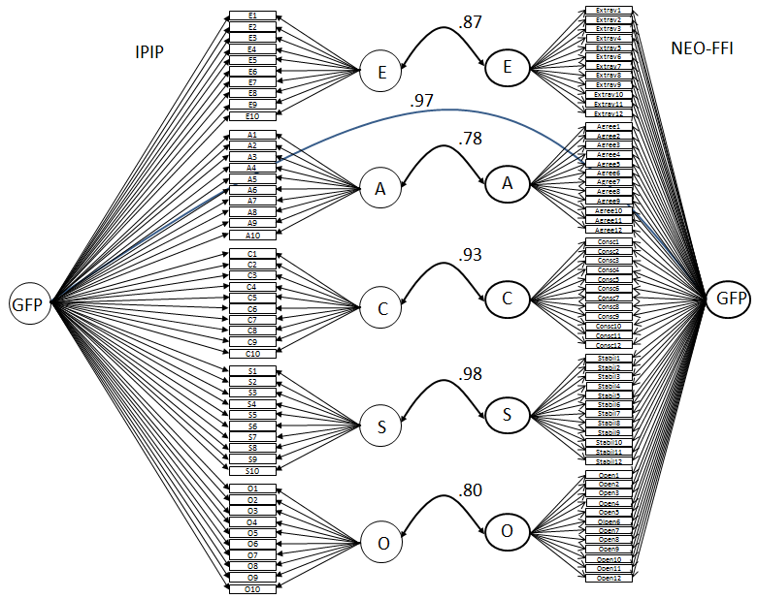
Convergent Validity of factors of IPIP 50-item scale vs. NEO-FFI
Biderman et al., 2011; N=195

Slide 23
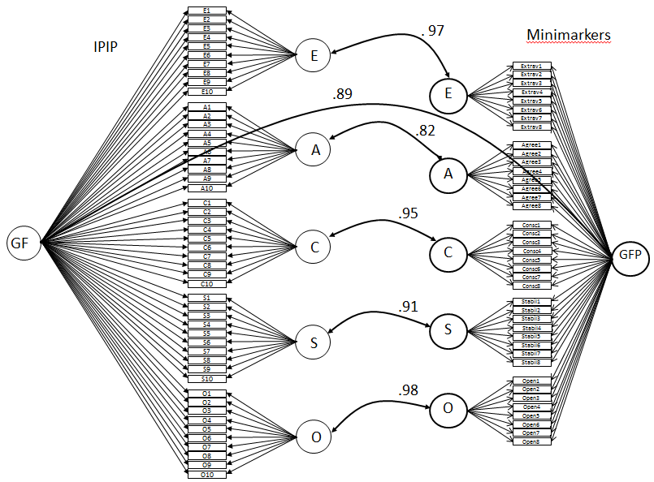
Convergent Validity of IPIP 50-item scale vs. Thompson Minimarkers
Unpublished data; N=206

Slide 24
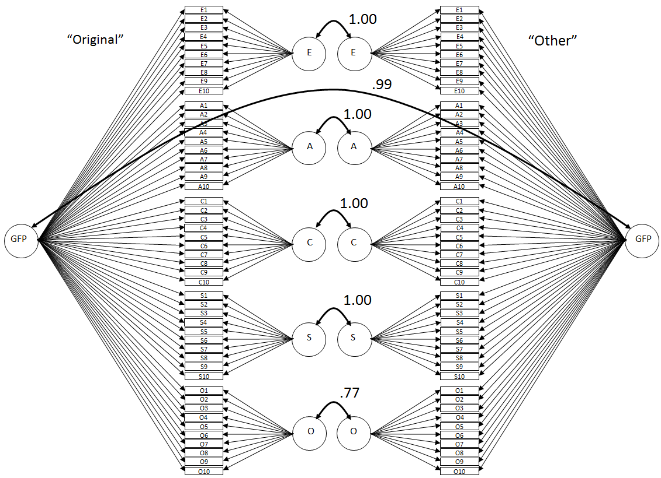
Convergent Validity of factors of “Original” vs “Other” IPIP scales
Unpublished data; N=206

Slide 25
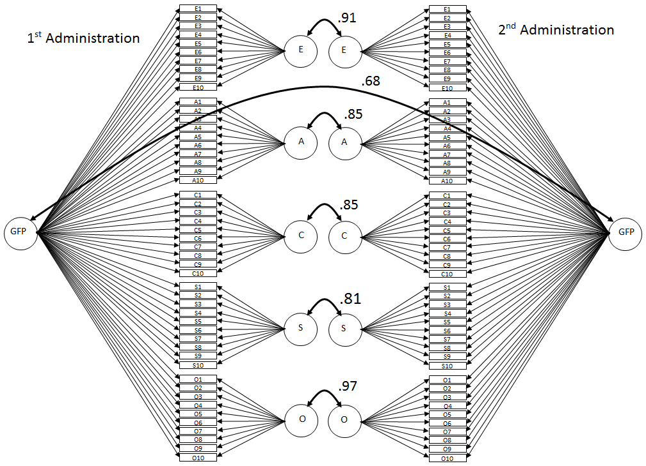
3 month test-retest correlations of factors of IPIP 50-item scale
Chen, Z. (2012). Test-retest correlations of factors of the IPIP 50-item scale. Unpublished dataset. University of Tennessee at Chattanooga.

Slide 26
Takeaway from the previous slides . . .
Whatever the bifactor is, it exhibits convergent validity across questionnaires and across time

Slide 27
Why should we apply a bifactor model?
If the bifactor model is true, this means that the bifactor affects, i.e., contaminates, each Big 5 response.
This is illustrated in the graphic on this slide . . .
The colored part of each response rectangle is
the portion of variance due to the influence of
the items’ Big Five trait
The white part is error of measurement
The black part is contamination from the bifactor.
Since the focus of most people using Big five questionnaires is not on the bifactor (yet) but on the Big Five factors, it is to our best interest to remove the effect of the
contamination.
E
A
GFP
C
S
O
Notes:
If this is the correct model, then it means that each item is contaminated by whatever the bifactor is.

Slide 28
The bifactor affects scale scores as well as individual responses
It’s not feasible to remove the contamination due to the bifactor by simply computing scale scores.
Big Five scale scores will be just as contaminated as individual responses.
So analyses involving scale scores will be affected – contaminated – by the bifactor.
Extraversion
Items
Extraversion
Scale Score
Extraversion + Contamination +
Error

Slide 29
Freedom from contamination!!
The solution to the dilemma is to apply a bifactor model to Big Five data and perform analyses involving the Big Five
factors in the model.
If the bifactor model fits, the group factors in the bifactor model
represent purer estimates of
each trait than do scale
scores for each domain.
Plus we get a free “sixth”
Score from the data – the
Bifactor score.
Purer Extraversiontion
E
Purer Agreeablenesstion
A
Purer Conscientiousness
GFP
C
Purer
Stability
S
Pure Whatever
Purer
Openness
O

Slide 30
Applying Bifactor Models
Specifically, a bifactor measurement model must first be applied.
Then a structural model – a set of correlations or regressions involving factors from the measurement model – is computed to test whatever hypotheses we might have regarding the Big Five factors.
Measurement models
Amos Graphics
Amos Program Editor
EQS
Mplus
Structural Models
Amos
Mplus
Caution – some of the following slides are pretty dense. Don’t worry, the test over them will be multiple choice.

Slide 31
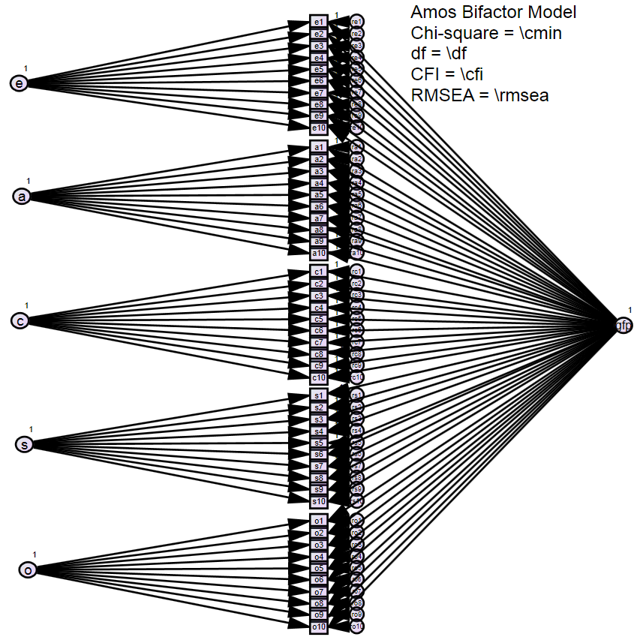
Bifactor measurement model – in Amos Graphics

Slide 32
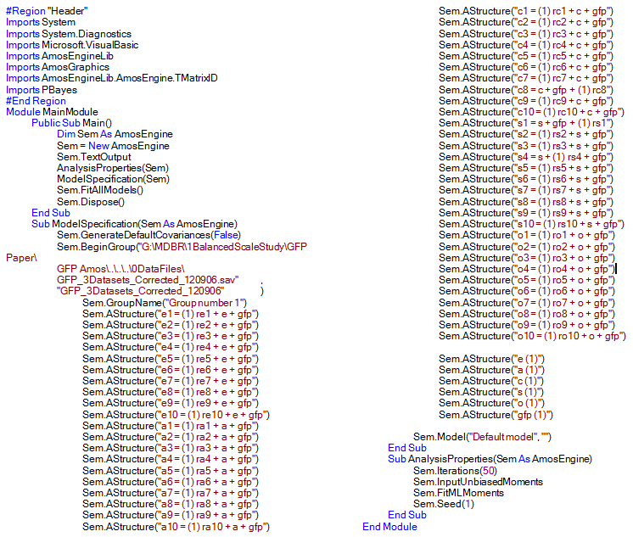
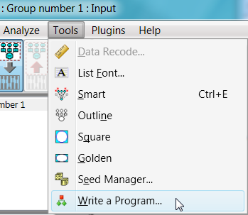
Bifactor measurement model – in Amos Program Editor

Slide 33
Bifactor measurement model - EQS

Slide 34
Bifactor measurement model - Mplus
TITLE: Bifactor GFP model with items as indicators;
data: FILE IS
'G:\MdbR\1BalancedScaleStudy\GFP Paper
\GFP Mplus\GFPData_120907.dat';
listwise=on;
variable: names are
Id wpt age gender ethnic filenum crit
ext agr con sta opn
e1 - e10
a1 - a10
c1 - c10
s1 - s10
o1 - o10
dep rse;
usevariables are e1-o10;
analysis: type = general ;
INFORMATION=EXPECTED;
model:
e by e1-e10*1;
a by a1-a10*1;
c by c1-c10*1;
s by s1-s10*1;
o by o1-o10*1;
gfp by e1-o10*1;
e@1; a@1; c@1; s@1; o@1; gfp@1;
gfp with e-o@0;
e-o with e-o@0;
output: modindices(20) standardized fsdeterminacy;
savedata: file is
'G:\MdbR\1BalancedScaleStudy\GFP Paper
\GFP Mplus\ZFS_BifactorModel.inp';
save=fscores;

Slide 35
Applying Bifactor Models - Structural Models
Within-the-program method
Assess the structural model from within the program that applied the model.
Factor score method
Use a program to applied the model to create factor scores of the latent variables in the measurement model.
Put the factor scores in your favorite statistical package.
Perform the regressions using your statistical package.

Slide 36
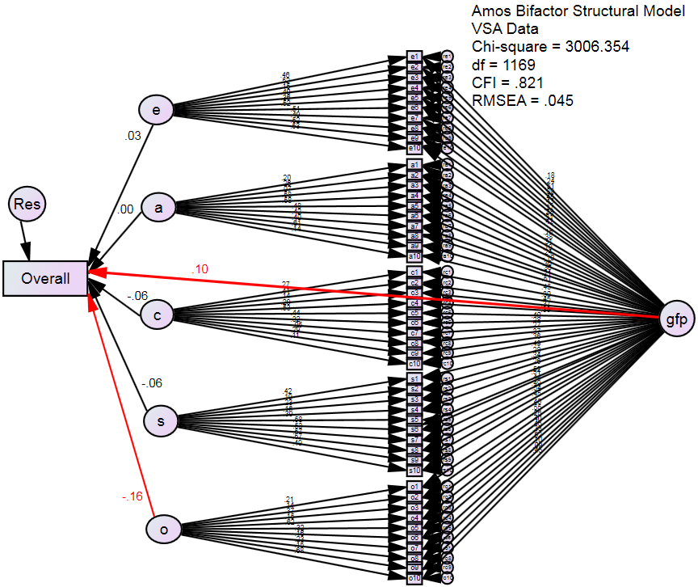
Assessing a structural model from within Amos Graphics
Assessing criterion related validity of Big Five factors + Bifactor
Criterion (Overall) is supervisor ratings of job performance. N=764.

Slide 37
Assessing a structural model within Amos Program Editor

Slide 38
Assessing a structural model from within Mplus
The data are the same as in the previous slide.
The model statements
model:
e by e1-e10*1;
a by a1-a10*1;
c by c1-c10*1;
s by s1-s10*1;
o by o1-o10*1;
gfp by e1-o10*1;
e@0;a@0;c@0;s@0;o@0;
gfp@0;
gfp with e-o@0;
e-o with e-o@0;
Overall on e-o gfp;
Key portions of the Mplus output
Two-tailed
OVERALL ON Estimate S.E. Est/S.E. P-Value
E 0.033 0.048 0.701 0.483
A -0.002 0.045 -0.049 0.961
C -0.059 0.056 -1.059 0.290
S -0.063 0.049 -1.286 0.198
O -0.158 0.047 -3.388 0.001
GFP 0.104 0.045 2.321 0.020
Measurement Model
Structural Model

Slide 39
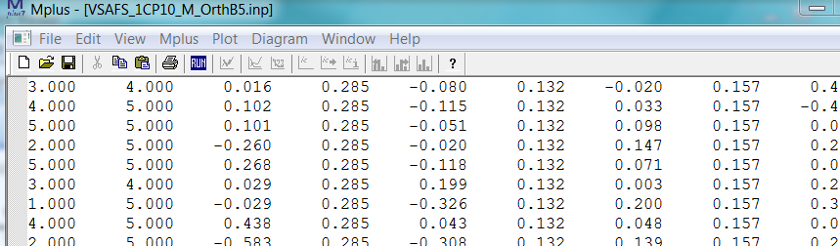
Assessing a structural model using factor scores from Mplus - 1
Key portions of the Mplus program measurement model
model:
e by e1-e10;
a by a1-a10;
c by c1-c10;
s by s1-s10;
o by o1-o10;
gfp by e1-o10;
gfp with e-o@0;
e-o with e-o@0;
output: modindices(20) standardized fsdeterminacy;
savedata: file is 'G:\MdbR\1Vikus\FS_1CP10_M_OrthB5.inp';
save=fscores;
A factor score file saved by Mplus with
1) the raw data, 2) the factor scores, and 3) the standard errors of the factor scores.
Note: Measurement model only
Commands to save factor scores

Slide 40
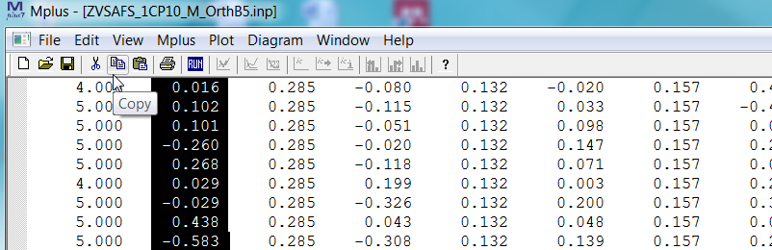
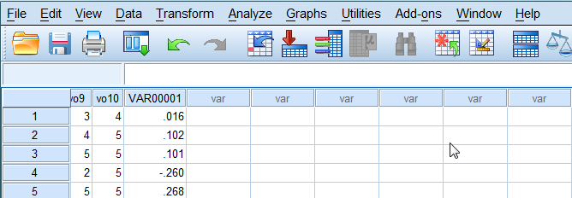
Assessing a structural model using factor scores from Mplus - 2
“Alt-copy” each factor score column.
Paste the column into a statistical package data editor window.
Continue to “alt-copy” and paste until all data have been moved.

Slide 41
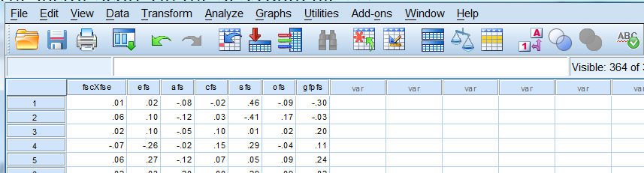
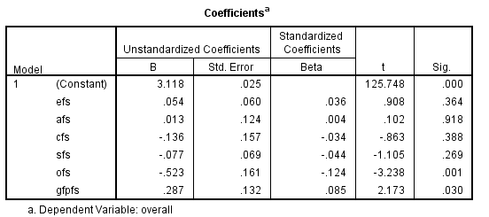
Assessing a structural model using factor scores from Mplus – 3
The factor Scores in an SPSS data file . . .(renamed as efs, afs, etc.)
The key output from the SPSS analysis

Slide 42
Issues surrounding bifactor models
1) Relationship to common method factors
2) Whether factors should be uncorrelated
3) What the indicators should be
4) Whether the model has to be a CFA

Slide 43
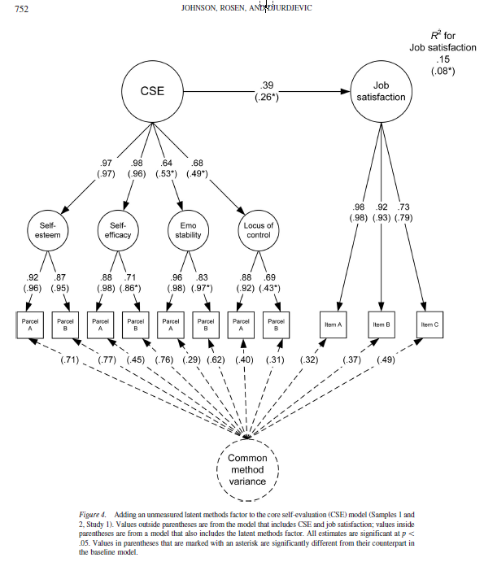
Issues – 1: Relationship to common method factors
The bifactor is a form of common method factor.
It is a factor that influences all behavior collected in administration of the questionnaire.
Example of a classic model –Johnson, R. E., Rosen, C. C., & Djurdjevic, E. (2011). Assessing the impact of common method variance on higher order multidimensional constructs. Journal of Applied Psychology, 96, 744-761.

Slide 44
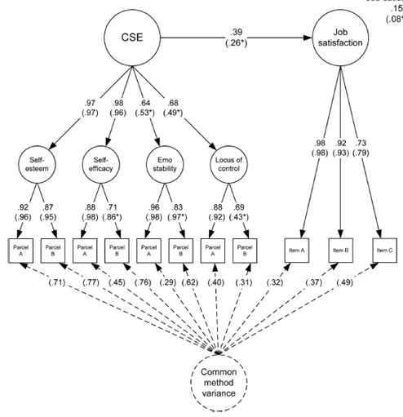
Issues – 1: Relationship to
common method factors
Common method factor model: May be structural relationships between group factors
Bifactor: Group factors often uncorrelated and exogenous.
Bottom line: Much of
what we know about
common method factors
applies to bifactor
models
Extrav1
Extrav2
Extrav3
Extrav4
E
Extrav5
Extrav6
Extrav7
Extrav8
Extrav9
Extrav10
Agree1
Agree2
Agree3
Agree4
A
Agree5
Agree6
Agree7
Agree8
Agree9
Agree10
Consc1
Consc2
Consc3
GFP
Consc4
C
Consc5
Consc6
Consc7
Consc8
Consc9
Consc10
Stabil1
Stabil2
Stabil3
Stabil4
S
Stabil5
Stabil6
Stabil7
Stabil8
Stabil9
Stabil10
Open1
Open2
Open3
O
Open4
Open5
Open6
Open7
Open8
Open9
Open10

Slide 45
Issues – 2 continued: Should the factors be uncorrelated?
The general factor must be uncorrelated with the group factors – for identification.
Extrav1
Extrav2
Extrav3
Extrav4
E
Extrav5
Extrav6
Extrav7
Extrav8
Extrav9
Extrav10
X
Agree1
Agree2
Agree3
Agree4
A
Agree5
Agree6
Agree7
Agree8
Agree9
Agree10
Consc1
Consc2
Consc3
GFP
Consc4
C
Consc5
Consc6
Consc7
Consc8
Consc9
Consc10
Stabil1
Stabil2
Stabil3
Stabil4
S
Stabil5
Stabil6
Stabil7
Stabil8
Stabil9
Stabil10
Open1
Open2
Open3
O
Open4
Open5
Open6
Open7
Open8
Open9
Open10

Slide 46
Issues – 2 continued:
Should the group
factors be uncorrelated?
Hmm.
Extrav1
Extrav1
Extrav2
Extrav2
Extrav3
Extrav3
Extrav4
E
Extrav4
E
Extrav5
Extrav5
Extrav6
Extrav6
Extrav7
Extrav7
Extrav8
Extrav8
Extrav9
Extrav9
Extrav10
Extrav10
Agree1
Agree1
Agree2
Agree2
Agree3
Agree3
Agree4
A
Agree4
A
Agree5
Agree5
Agree6
Agree6
Agree7
Agree7
Agree8
Agree8
Agree9
Agree9
Agree10
Agree10
Consc1
Consc1
Consc2
Consc2
Consc3
Consc3
GFP
Consc4
C
Consc4
C
Consc5
vs
GFP
Consc5
Consc6
Consc6
Consc7
Consc7
Consc8
Consc8
Consc9
Consc9
Consc10
Consc10
Stabil1
Stabil1
Stabil2
Stabil2
Stabil3
Stabil3
Stabil4
S
Stabil4
S
Stabil5
Stabil5
Stabil6
Stabil6
Stabil7
Stabil7
Stabil8
Stabil8
Stabil9
Stabil9
Stabil10
Stabil10
Open1
Open1
Open2
Open2
Open3
O
Open3
O
Open4
Open4
Open5
Open5
Open6
Open6
Open7
Open7
Open8
Open8
Open9
Open9
Open10
Open10

Slide 47
Issues – 2 continues: Should the Group factors be correlated?
Most applications constrain the group factors to be orthogonal.
There may be bifactor purists who would say that a model is not a bifactor model unless that is the case.
We have explored models in which the group factors have been allowed to correlate with each other. (e.g., Biderman et al., 2011)
Group factors will be assumed to be orthogonal for what follows here.

Slide 48
Issues – 3: What should be the indicators?
Should be the indicators of the factors be items or parcels or scale scores?
Let’s rule out scale scores.
Group factors are contaminated with error of measurement.
.
So either items or parcels must be indicators.
Ext
Error + E
Agr
Error + A
GFP
Con
Error + C
Sta
Error + S
Opn
Error + O

Slide 49
Issues – 3 continued: Items as indicators
Many models use items as indicators.
Advantages of items
Unambiguity with respect to the effect of item characteristics – content, valence, wording
Disadvantages of items
May require estimation of too many parameters – twice as many loadings as a regular CFA
Unusual items may have undo influence on results.
Goodness-of-fit suffers when items are indicators

Slide 50
Issues – 3 continued: Parcels as Indicators
Some applications use parcels as indicators.
Advantage of parcels
Parcels more likely to meet normality, etc assumptions.
Parcels may mask uninteresting item characteristics
Model goodness-of-fit measures are better when parcels are indicators
Disadvantages of parcels
Parcels may mask interesting item characteristics – content, valence, wording
Specific choice of parcels may influence the solution.
In all of what follows, items were indicators.

Slide 51
Issues 4 – Does a bifactor model have to be a CFA?
The original presentation of bifactor models (Holzinger & Swineford, 1937) was as an exploratory factor model.
Most current applications are CFAs.
Mplus Version 7 can easily apply an EFA bifactor model.
Here’s the Mplus code to specify a bifactor model
usevariables are e1-o10;
analysis: type = EFA 6 6 ;
ROTATION = BI-GEOMIN(ORTHOGONAL);
All following applications will be CFAs.

Slide 52
Examples of applications of bifactor models to Big Five data
1) Bifactor as a contaminant in Big Five predictions of objective criteria
2) Bifactor and correlations involving Big Five dimensions with measures of affect
3) Bifactor and correlations involving only non Big 5 variables with affective components
4) Bifactor as a predictor

Slide 53
Application Examples – 1: Contaminant of UGPA predictions
Comparing the validity of Conscientiousness scale score with validity of factor scores.
Conscientiousness + Contamination
Criterion
vs
C
Criterion
Predictors: Conscientiousness Scale scores vs Conscientiousness Factor Scores
Criterion: Undergraduate GPA or test scores
Questionnaires: IPIP Original 50-item Scale
Validity of Validity of C
Study Scale Scores factor Scores
Biderman, Nguyen, Sebren (2008) N=166 .125 .177
Biderman (2010 unpublished) N=206 .249 .274
Reddock, Biderman, & Nguyen (2011) N=329 .196 .168
Biderman, Worthy, Nguyen, Mullins, & Luna (2012) N=328 .079 .080
Nguyen & Biderman, 2013 N=288 .165 .202
So, there is some evidence that eliminating bifactor contamination results in larger correlations of conscientiousness with UGPA.
Mean loading of C items on bifactor is .21, so only about 4% of variance in C scale scores is due to individual differences in the bifactor. So effect size is small.

Slide 54
Application Examples – 2: Bifactor and correlations of Big 5 dimensions with Positive and Negative Affectivity
Data: N=202
Participants responded to IPIP Original 50-item Scale.
Participants responded to PANAS.
Computed correlations of Big 5 scale scores with PA and NA.
Computed correlations of Big Five factor scores from bifactor model with PA and NA.
Biderman, M. D., Nguyen, N. T., & Cunningham, C.J.L., & Ghorbani, N. (2011). The ubiquity of common method variance: The case of the Big Five. Journal of Research in Personality, 2011, 45, 417-429.

Slide 55
Application Examples – 2: Correlations of scale and factor scores with PA
Big Five scale scores all correlated positively with PANAS Positive Affectivity.
(p < .05 for red correlations.) N=202
Factor scores from a bifactor model exhibited smaller correlations with PA than did scale scores.
.46
GFP
.34
.17
Ext
E
.23
PA
.-06
Agr
A
.23
.08
Con
.32
C
Sta
.35
.16
S
Opn
.12
O

Slide 56
Application Examples – 2: Correlations of scale and factor scores with NA
Same study as above, except that correlations with NA were compared.
Factor scores from the Bifactor model exhibited much smaller correlations with NA than did scale scores.
-.36
GFP
-.24
-.09
Ext
E
-.17
NA
.12
Agr
A
-.18
-.05
Con
-.63
C
Sta
-.19
-.33
S
Opn
.00
O

Slide 57
Application Examples – 2 continued: Bifactor and Big Five correlations with Self-esteem and Depression
Data: N = 206
Participants responded to IPIP Sample 50-item Questionnaire.
Participants responded to Costello and Comrey (1967) Depression scale.
Participants responded to Rosenberg (1965) Self-esteem scale
Bifactor model was applied to Big Five data.
Big 5 scale scores were correlated with Self-esteem and Depression.
Factors were correlated with Self-esteem and Depression in the following three ways….
Biderman, M. D., Nguyen, N. T., Cunningham. (2011). A method factor measure of self-concept. Paper presented at the 26th Annual Conference of The Society for Industrial and Organizational Psychology, Chicago, IL.

Slide 58
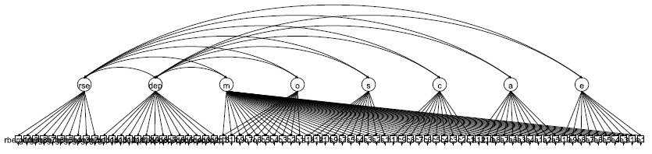
Application Examples – 2 continued: Factor correlations of Self-esteem and Depression with factors – 3 ways to evaluate
1) Within-program (Mplus) correlations of Big Five with Self-esteem and Depression factors were computed using the following model (m is the bifactor in the model) . . .
2) Bifactor model was applied to only the Big Five data and factor scores computed from that model were correlated with Self-esteem and Depression scale scores.
Big Five scale scores were correlated with Self-esteem and Depression scale scores partialling out bifactor factor scores from a Big 5 bifactor model.

Slide 59
Application Examples – 2 continued:
Big Five correlations with Self-esteem and Depression
Correlations in red: p < .05
Self-esteem E A C S O Bifactor
Scale correlations .285 .188 .381 .242 .359
Factor correlations .078 -.006 .328 .100 .209 .479
Factor score correlations .081 .002 .317 .077 .269 .406
Scale rs partialling bifactor -.016 -.085 .335 .073 .230
Depression
Scale correlations -.202 -.309 -.330 -.284 -.192
Factor correlations -.005 -.117 -.328 -.177 .047 -.404
Factor score correlations .005 -.124 -.279 -.114 -.075 -.365
Scale rs partialling bifactor .099 -.115 -.282 -.145 .049
Notes:
1) Diminishing 2) Similarity of 3 methods of correlating factors 3) Huge bifactor correlations

Slide 60
Application Examples – 2: Correlations with measures of affect
Take away from these examples . . .
1) Controlling for the bifactor diminishes correlations of Big Five dimensions with measures of positive and negative affect.
2) The bifactor estimated from Big Five data is positively correlated with measures of positive affect and negatively correlated with measures of negative affect.
Structural correlations
a) from within program
b) of factor scores and
c) of scale scores partialling bifactor
were similar

Slide 61
Application Examples – 3: Bifactor and correlations among non Big Five variables with affective components
Correlations of Maslach Burnout Scale with Core Self Evaluations, Hardiness, and Extraversion from questionnaire given to 300+ Nurses
Bifactor model applied to only the Big Five data and factor scores computed.
Note: Bifactor was not indicated by items from the burnout, hardiness or CSE scales.
All values in red: p < .05
Hardiness CSE Extraversion
Simple Correlations with Burnout scale -.616 -.646 -.265
Partialling out bifactor factor scores -.521 -.564 -.019
Z testing significance of difference -4.67 -4.57 -6.33
Ecie, M. (2013). Relationships among nursing burnout, the Big Five personality factors, and overall self-concept: The impact of assessing common method variance. Master’s Thesis submitted to The University of Tennessee at Chattanooga.

Slide 62
Application Examples – 4
Bifactor as a predictor
These results were presented above. N=764.
Extrav1
M
Extrav2
Extrav3
Extrav4
Extrav5
Extrav6
.10
Extrav7
Extrav8
Extrav9
Extrav10
Agree1
E
Agree2
Agree3
.03
Agree4
Agree5
Agree6
Agree7
Agree8
Agree9
A
Agree10
.00
Consc1
Consc2
Supervisor Evaluation
Consc3
Consc4
Consc5
-.06
Consc6
Consc7
C
Consc8
Consc9
Consc10
Stabil1
Stabil2
Stabil3
-.06
Stabil4
Stabil5
S
Stabil6
Stabil7
Stabil8
-.16
Stabil9
Stabil10
Open1
Open2
Biderman, M. D., Nguyen, N. T., Mullins, B., & Luna, J. (2008). A method factor predictor of performance ratings. Paper presented at the 23rd Annual Conference of The society for Industrial and Organizational Psychology, San Francisco.
Open3
O
Open4
Open5
Open6
Open7
Open8
Open9
Open10

Slide 63
What is the bifactor in Big Five data? - 1
Specifically it’s common variation - a tendency to respond slightly more positively or slightly more negatively to items than would be expected on the basis of the respondent’s position on the trait.
It’s a slight elevation of responses to all items or
a slight “delevation” of responses to all items.
People high on the bifactor respond with slightly higher responses to all items than if the bifactor were not affecting their responses.
People low on the bifactor respond with slightly lower responses to all items than they would if the bifactor were not affecting their responses.
Interesting result: Since the Big Five factors are essentially orthogonal, a person’s score on the bifactor can be estimated by simply taking the mean of ALL responses on the Big Five questionnaire.

Slide 64
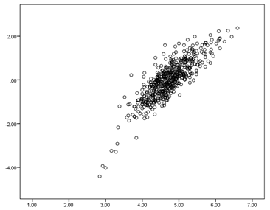
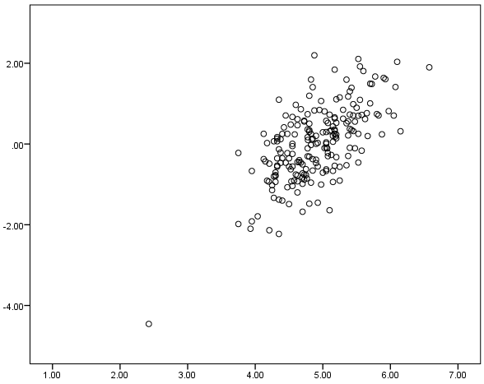
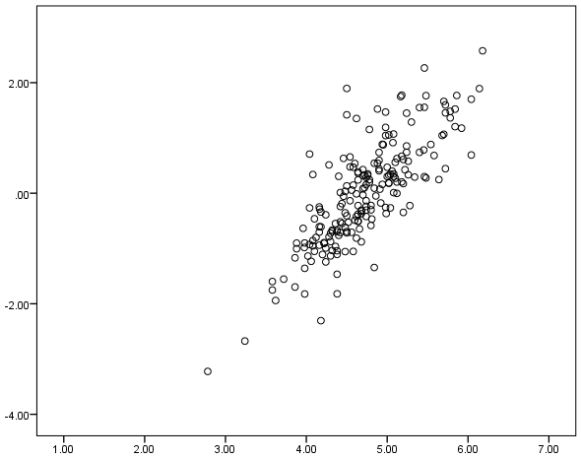
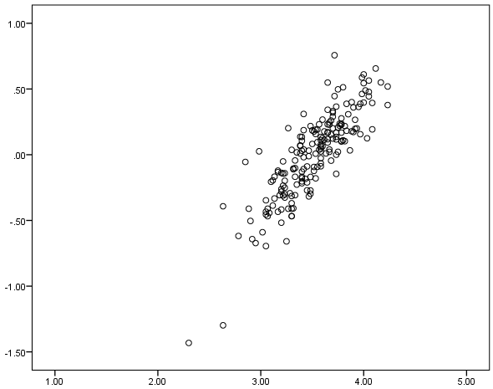
What is the bifactor in Big Five data? – 2
Scatterplots of bifactor factor scores vs. mean of responses to all items.
IPIP 50-item
N=547
r = .846
Minimarkers
N=206
r = .651
Bifactor Factor Score
Bifactor Factor Score
Mean of All Items
Mean of All Items
“Other” 50-items
N=206
r = .799
NEO-FFI
N=189
r = .849
Bifactor Factor Score
Bifactor Factor Score
Mean of All Items
Mean of All Items

Slide 65
What is the bifactor in Big Five data? - 3
The evidence: Individual differences in the bifactor . . .
are positively correlated with positive affect and self-esteem . . .
are negatively correlated with negative affect and depression . . .
are positively correlated with supervisor evaluations.
These results suggest that the bifactor represents the affective or emotional state of the respondent
High bifactor value – the respondent is feeling good about her/himself – will score high on PA and self-esteem, low on NA and depression, and be evaluated favorably by supervisor
Low bifactor value – the respondent is feeling down - will score low on PA and self-esteem, high on NA and depression and be evaluated less favorably by supervisor.

Slide 66
What is the bifactor in Big Five data? – 4
Déjà vu all over again: Self-report of affective state is not a new concept
McCrae, R. R., & Costa, P. T. (1995). Positive and negative valence within the five-factor model. Journal of Research in Personality 29, 443-460.
Saucier, G. (2002). Orthogonal markers for orthogonal factors: The case of the Big Five. Journal of Research in Personality, 36, 1-31.
Tellegen, A., Watson, D. & Clark, L. A. (1999). On the dimensional and hierarchical structure of affect. Psychological Science, 10, 297-303.
From Block, J. (1995). A contrarian view of the five-factor approach to personality description. Psychological Bulletin, 117, 187-215.
“However, the empirical research findings indicate that the five factors are frequently importantly correlated with each other, usually to reflect an overriding evaluative component.”

Slide 67
How is what is presented here different from what’s been done in the past?
Affective state modeled here as a bifactor
Previous applications have sought separate indicators for factors representing affect - not shared indicators.
Modeled here as a part of any Big Five questionnaire
The items on the questionnaires modeled here were chosen to represent the Big Five, not affective state.
Big Five items are typically selected to omit evaluation
Modeled here as orthogonal to the Big Five dimensions
The affect represented by the bifactor is independent of the Big Five

Slide 68
Items and the bifactor - 1
If this expression of affect is coming from the items, how is it related to them?
How are the items of the Big Five related to the bifactor
What items are most affected by the bifactor?
Bäckström, M., Björklund, F. & Larsson, M. R. (2009). Five-factor inventories have a major general factor related to social desirability which can be reduced by framing items neutrally. Journal of Research in Personality, 43, 335- 344.
Bäckström et al. showed that neutrally worded items had generally smaller loadings on the bifactor.
What follows is an extension of the work of Bäckström et al.

Slide 69
Items and the bifactor - 2
Looking for what item characteristics are related to the bifactor
Data: N=547
Bifactor model applied to IPIP 50-item Big 5 questionnaire data.
Negatively-worded items were not reverse-scored.
(Results are the same as if items not reverse-scored,
except that signs of loadings are reversed.)
Focused on loadings of individual items on the bifactor.

Slide 70

Items and the bifactor – 3
Loadings of 50-item scale items on the bifactor
Filled circles represent positively worded items
Bifactor does not represent blind acquiescence or most loadings would be positive.
Loadings near 0: Bifactor has little effect on those items.
Extreme loadings - far from 0: – Bifactor has a large effect of the bifactor on them.

Slide 71
Items and the bifactor - 4
What is the item characteristic that is related to the loadings?
Our hypothesis was that the salience of an item for the bifactor depends on the item’s valence.
Positive valence: Item says something good about you
I am interested in people.
I make people feel at ease.
Negative valence: Item says something bad about you
I insult people.
I often feel blue.
People feeling good about themselves will agree with the positively valenced items and disagree with the negatively valenced items.

Slide 72
Item valence and bifactor loadings - 1
Data: N=366
We had students estimate valence of each IPIP item.
Instructions:
Think about how people you care about would evaluate you if you had the characteristic mentioned in the statement.
  4: “They would say that if I had this characteristic, it would make me look absolutely good.”
. . .
0: “They would say that if I had this characteristic, it would make me look absolutely bad.”
Chen, Z. (2012). Valence judgments of Big Five items. Unpublished manuscript. University of Tennessee at Chattanooga.

Slide 73
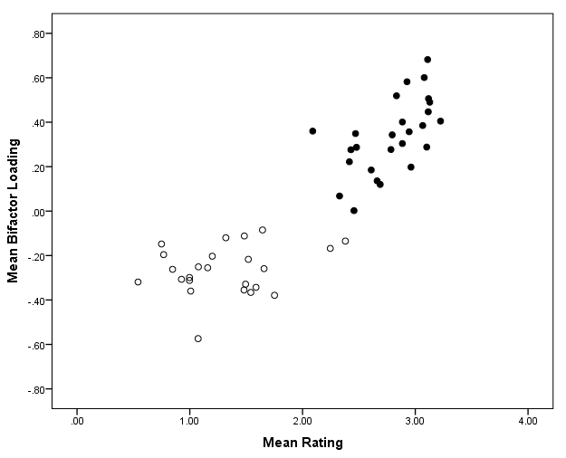
Item valence and bifactor loadings - 2
Bifactor Loadings vs. Mean Valence Ratings
Overall r = .884
Bifactor loading
r for positively-worded items = .592
r for negatively-worded items = .240
Valence rating
Notes:
Loadings reflected both whether an item was positively or negatively worded but also more subtle differences in valence.

Slide 74
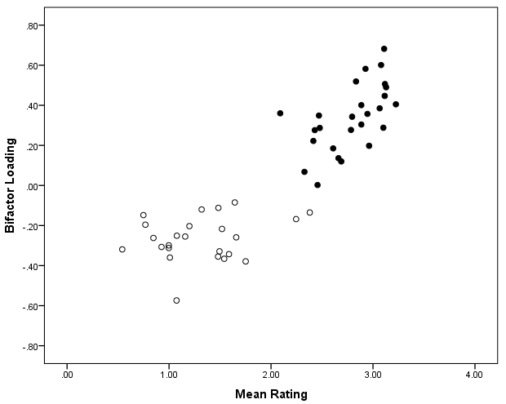
Item valence and bifactor loadings - 3
Wordings of selected items.
I feel comfortable around people
I start conversations
I am interested in people
I talk to a lot of different people at parties
I make people feel at ease
I take time out for others
Bifactor loading
I have a rich vocabulary
I worry about things
I use difficult words
I get stressed out easily
I don’t like to draw attention to myself
I insult people
I often feel blue
I am not really interested in others
Valence rating

Slide 75
Takeaway from the previous slides
The bifactor of the Big Five appears to represent the respondent’s affective state.
Influence of the bifactor on items is related to item valence
Persons high on the bifactor will be most likely to agree with items with highest positive valence and to disagree with items with the lowest valence

Slide 76
What to do with the bifactor - 1
Get rid of it.
Following Bäckström et al.
Design scales free of contamination from the bifactor: Items whose valence is least extreme – those around 2 on the 0-4 scale used here - would be expected to have the smallest amount of contamination by the bifactor.
Clearly such information can be used to “purify” scale scores by basing them on items with less extreme valence – less contamination – as Bäckström et al. did.

Slide 77
What to do with the bifactor – 2
Embrace it
Design scales to assess the bifactor along with the Big Five. Select items with extreme valence for questionnaires.
Maximize individual differences in the expression of affect represented by the bifactor.
Use the bifactor to assess affective state by administering a Big Five questionnaire
Use it as a controlling variable to partial out affective state.
Use it as a predictor of performance involving affective characteristics

Slide 78
Summary
1. Strong evidence that there is common item variance in Big Five data – nicely accounted for by a model with a bifactor.
2. Strong evidence that the Big Five bifactor is related to measures that involve affect, suggesting that it is a measure of general affective state.
3. Strong evidence that controlling for the bifactor affects self-report correlations contaminated by affect.
4. Evidence that items with extreme valence are most strongly related to differences in the bifactor.

Slide 79
Caveats
Big Five bifactor is not identical to bifactors estimated from other questionnaires
or Big Five questionnaires obtained under unusual instructional conditions
Item content may overwhelm the valence effect
Instructions and incentives to fake overwhelm the valence effect
Nonconvergence – always a problem with models involving crossed factors.
Multiple solutions – Occasionally, we’ve encountered datasets with two solutions.

Slide 80
Bifactor poem
“Bifactor bifactor where have you been?”
“Hiding among the items so that when
you correlate and predict,
my contamination will stick
to your measures like gum on a shoe.
Leaving you with a confusing data stew.”

Slide 81
The End

Slide 82
References - 1
Bäckström, M., Björklund, F. & Larsson, M. (2009). Five-factor inventories have a major general factor related to social desirability which can be reduced by framing items neutrally. Journal of Research in Personality, 43, 335- 344.
Biderman, M. D., Nguyen, N. T., Cunningham, C. J. L., & Ghorbani, N. (2011). The ubiquity of common method variance: The case of the Big Five. Journal of Research in Personality, 45, 417-429.
Biderman, M. D., Nguyen, N. T., Cunningham, J. L., Chen, Z., & Watson, P. J. (2013). Method factors, bifactors, and item valence. Paper accepted for presentation at the 28th Annual Conference of The Society for Industrial and Organizational Psychology, Houston, TX.
Biderman, M. D., Nguyen, N. T., Cunningham. (2011). A method factor measure of self-concept. Paper presented at the 26th Annual Conference of The Society for Industrial and Organizational Psychology, Chicago, IL.
Biderman, M. D., Nguyen, N. T., & Sebren, J. (2008). Time-on-task mediates the conscientiousness-performance relationship. Personality and Individual Differences, 44, 887-897.
Biderman, M. D., Worthy, R., Nguyen, N. T., Mullins, B., & Luna, J. (2012). Criterion-related validity of three personality questionnaires. Paper accepted for presentation at the 27th Annual Conference of The Society for Industrial and Organizational Psychology, San Diego, CA.
Block, J. (1995). A contrarian view of the five-factor approach to personality description. Psychological Bulletin, 117, 187-215.
Brunner, M., Nagy, G., & Wilhelm, O. (2012). A tutorial on hierarchically structured constructs. Journal of Personality, 80, 796-846.
Bäckström, M., Björklund, F. & Larsson, M. R. (2009). Five-factor inventories have a major general factor related to social desirability which can be reduced by framing items neutrally. Journal of Research in Personality, 43, 335- 344.

Slide 83
References - 2
Chen, F. F., West, S. G., & Sousa, K. H. (2006). A comparison of bifactor and second-order models of quality of life. Multivariate Behavioral Research, 41, 189-225.
Costello, C. G., & Comrey, A. L. (1967). Scales for measuring depression and anxiety. The Journal of Psychology, 66, 303-313.
Ecie, M. (2013). Relationships among nursing burnout, the Big Five personality factors, and overall self-concept: The impact of assessing common method variance. Master’s Thesis submitted to The University of Tennessee at Chattanooga.
Holzinger, K. J., & Swineford, F. (1937). The bi-factor method. Psychometrika, 2, 41-54.
Johnson, R. E., Rosen, C. C., & Djurdjevic, E. (2011) Assessing the impact of common method variance on higher order multidimensional constructs. Journal of Applied Psychology, 96, 744-761.
Marsh, H. W., Scalas, L. F., & Nagengast, B. (2010). Longitudinal tests of competing factor structures for the Rosenberg Self-esteem Scale: Traits, ephemeral artifacts, and stable response styles. Psychological Assessment, 22, 366-381.
McCrae, R. R., & Costa, P. T. (1995). Positive and negative valence within the five-factor model. Journal of Research in Personality 29, 443-460.
Nguyen, N. T., & Biderman, M. D. (2013). Predicting counterproduct work behavior from a bi-factor model of Big Five personalty. Paper accepted for presentation at the annual meeting of the Academy of Management, Orlando, FL.
Reddock, C. M., Biderman, M. D., & Nguyen, N. T. (2011). The relationship of reliability and validity of personality tests to frame-of-reference instructions and withihn-person inconsistency. International Journal of Selection and Assessment, 19, 119-131.
Reise, S. P. (2012). The rediscovery of bifactor measurement models. Multivariate Behavioral Research, 47, 667-696.

Slide 84
References - 3
Reise, S. P., Moore, T. M., & Haviland, M. G. (2010). Bifactor models and rotations: Exploring the extent to which multidimensional data yield univocal scale scores. Journal of Personality Assessment, 92, 544-559.
Reise, S. P., Scheines, R., Widaman, K. F., & Haviland, M. G. (2012). Multidimensionality and structural coefficient bias in structural equation modeling: A bifactor perspective. Educational and Psychological Measurement, 73, 5-26.
Rosenberg, M. (1965). Society and the adolescent self image. Princeton, NJ: Princeton University Press.
Saucier, G. (2002). Orthogonal markers for orthogonal factors: The case of the Big Five. Journal of Research in Personality, 36, 1-31.
Tellegen, A., Watson, D. & Clark, L. A. (1999). On the dimensional and hierarchical structure of affect. Psychological Science, 10, 297-303.
Thompson, E. R. (2008). Development and validation of an international English Big-Five MiniMarkers. Personality and Individual differences, 45, 542-548.
Thompson, E. R. (2008). Development and validation of an international English Big-Five MiniMarkers. Personality and Individual differences, 45, 542-548.
Yung, Y., Thissen, D., & McLeod, L. D. (1999). On the relationship between the higher-order factor model and the hierarchical factor model. Psychometrika, 64, 113-128.

Slide 85
Questions?

Slide 86
Extra slides follow

Slide 87
More detail on loading patterns for Big 5 Questionnaires
Thompson MiniMarker; N=206
NEO – FFI; N=195
IPIP 50-item; N=547
Extrav1
Extrav1
Extrav2
Extrav2
Extrav3
Extrav3
Extrav4
Extrav4
Extrav5
E
.54
E
Extrav6
Extrav5
Shy
Extrav7
.22
Extrav6
Talkative
Extrav8
Extrav7
Energetic
.66
E
Extrav9
Extrav8
Quiet
.43
Extrav10
.36
Extrav9
Extraverted
Extrav11
Extrav10
Outgoing
Extrav12
.16
Reserved
Agree1
Agree1
Untalkative
Agree2
Agree2
Agree3
Agree3
Agree4
Agree4
Kind
Agree5
A
.43
A
Sympathetic
.35
Agree6
.36
Agree5
Harsh
A
Agree7
Agree6
Cooperative
.55
Agree8
Agree7
Unkind
Agree9
Agree8
Warm
Agree10
Agree9
.23
Rude
Agree11
.36
Agree10
Inconsiderate
Agree12
Consc1
Consc1
Consc2
Consc2
Efficient
Consc3
Consc3
Disorganized
Consc4
Consc4
.31
Careless
C
GFP
.23
Consc5
.52
C
.50
C
GFP
Untidy
.58
Consc6
GFP
.21
Consc5
Neat
Consc7
Consc6
Inefficient
Consc8
Consc7
Systematic
Consc9
Consc8
Consc10
Consc9
Organized
Consc11
Consc10
Envious
Consc12
.21
.06
Emotional
Stabil1
Stabil1
Stabil2
Stabil2
Anxious
.57
S
Stabil3
Stabil3
Unworried
Stabil4
.52
Stabil4
Jealous
.37
Stabil5
S
Stabil5
S
Unenvious
Stabil6
.56
Moody
Stabil7
Stabil6
Unanxious
Stabil8
Stabil7
Stabil9
Stabil8
.50
Stabil10
Stabil9
Creative
Stabil11
.33
Stabil10
Intellectual
Stabil12
Unimaginative
.37
O
Open1
Open1
Artistic
Open2
Open2
Intelligent
Open3
.46
Open3
Philosophical
-.05
Open4
Open4
O
Deep
Open5
O
Open5
.42
Uncreative
OIpen6
Open6
Open7
Open8
Open7
Open9
Open8
Open10
Open9
Open11
Open10
Open12
Notes:
There ARE differences across B5 questionnaires in the importance of the bifactor for different dimensions

Slide 88
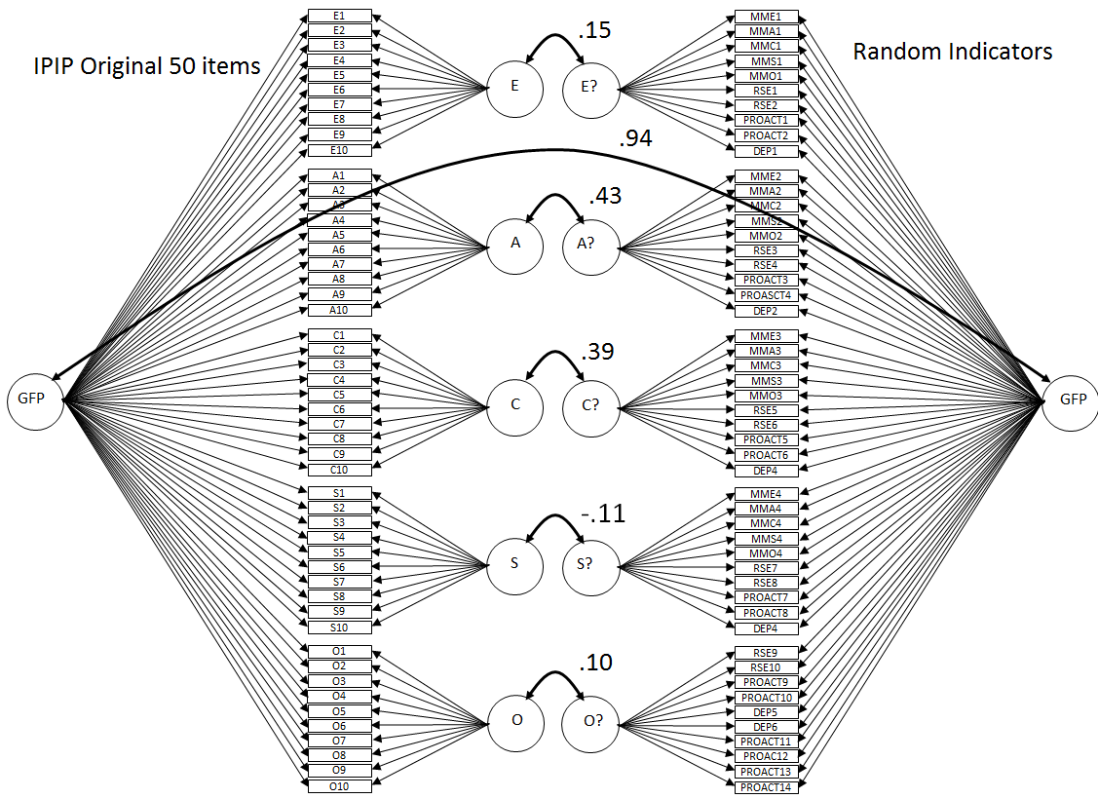
Convergent Validity with a questionnaire of random indicators
This slide shows that the bifactor represents a characteristic of self report that is independent of the specific content of the items.

Slide 89
Relationships with measures of affect in 4 datasets
  Mean of items Bifactor scores
  correlation with correlation with
Study Scale Negative Positive Negative Positive N
Incentive PANAS -.511 .496 -.282 0.407 202
Balanced Dep/RSE -.442 .494 -.365 0.406 206
Balanced Dep/RSE -.479 .542 -.390 0.411 206
Balanced Dep/RSE -.484 .576 -.335 0.524 206
Rosetta Dep/RSE -.318 .398 -.140 0.261 329
Evans Dep/RSE -.383 .501 106

